Slide 1
CAN Protocol
Subra Ganesan
Oakland University

Slide 2
Agenda
Vehicle Multiplexing – Introduction
CAN Systems
  CAN System - summary
  Messages, Frame Structure
  Chrysler CAN VMM
  Error handling
  Physical Layer
  CAN Tools

Slide 3
What are CAN & LIN?
CAN and LIN are in-vehicle multiplexing Technologies
  Multiplexing: one common channel is used for data transmission and reception between multiple stations
CAN and LIN are serial communication protocols for sending and receiving
Messages between nodes (Electronic control modules).
Transmitter 1
Transceiver 3
Receiver 1
Transceiver 1
Common Channel
Common Channel
Transmitter 2
Receiver 2
Transceiver 2
Transceiver 4

Slide 4
Why Vehicle multiplexing?
Requirements on safety, emissions, fuel economy and competitive new features
Size and weight reduction
Avoid complex wiring and redundant sensors
Diminishing installation space
Modularity
Improved diagnosis and serviceability
Improve cost

Slide 5
Local network
Confined in a small area
All stations are attached to a common wire
Transmission from one node propagates in both directions and can be received by all other nodes
Bus local network
Ring local network
Star local network

Slide 6
Multiplexing
Bus | Speed | Header | Physical Medium
CCD | 7.8125 KBS | 8-bit | Twisted wire
J1850 | 10.4 KBS | 8-bit | Single wire
CAN | ≤ 1 MBPS | 11-bit & 29-bit | Twisted Pair
LIN | ≤ 19.2 KBS | 8-bit | Single wire

Slide 7
Vehicle Multiplexing

Slide 8
Typical CAN Network
IOD
Audio Amplifier
IOD
IOD
R/S,RO
IOD,R/S
Satellite Radio Module
Radio w/CD,
or NAV Radio
Occupant Restraint Controller
Occupant Classification Module
CAN Bus System
IOD
Hands Free Module
Body Data Bus
IOD, R/S, W
RO
IOD, R/S, BAT, W
SKIM, RKE &
TPM Receiver
Compass Sensor
Smart Instrument Cluster
IOD,R/S, W
LIN bus
Multifunction Switch
Wireless Control Module
LIN bus
R/S
IOD,R/S
TPM Transponder Module - 3 total
I/P Switch Bank
BAT, R/S
BAT, R/S
AWD Control Module
CVT Control Module
BAT, IOD, R/S, W
Totally Integrated Power Module with CAN Bus Gateway
TIPM
Power train Data Bus
Diagnostic CAN-C
BAT, R/S
BAT, R/S
Powertrain Control Module NGC – 2.x L EDC16 - Diesel
ABS / Trac Module
Diagnostic Connector

Slide 9
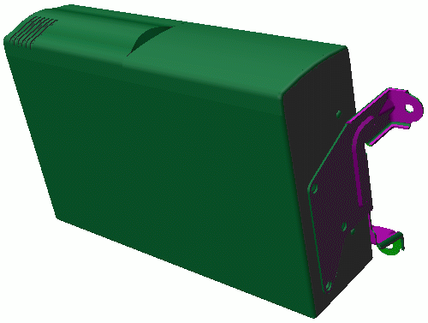
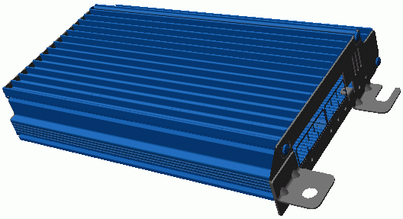
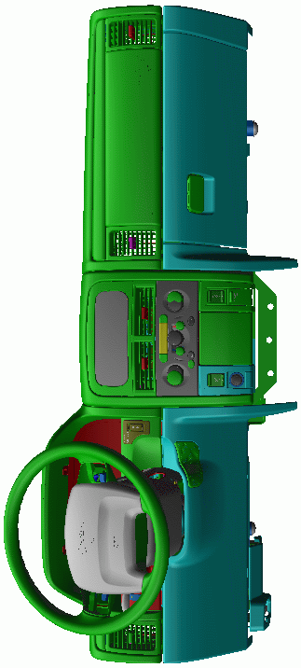

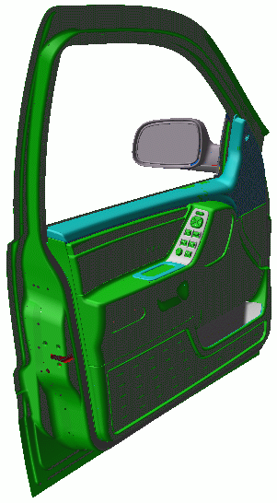

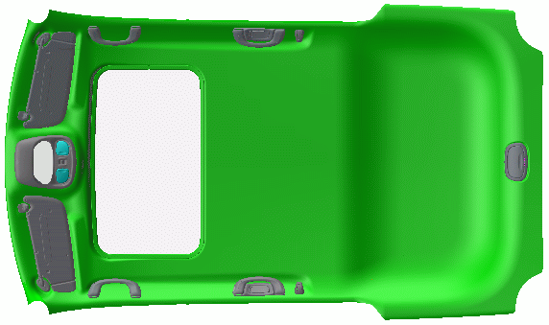
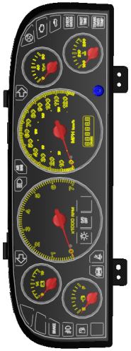
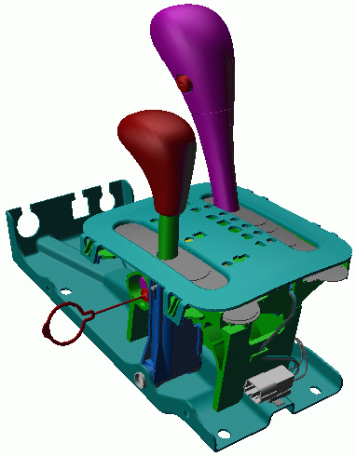
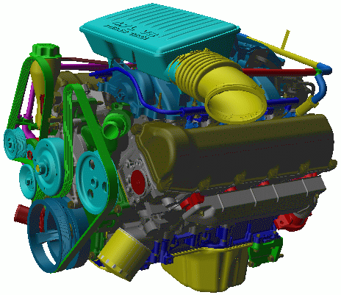
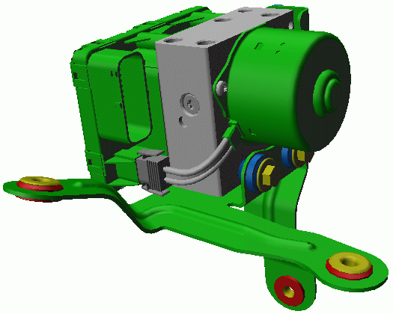
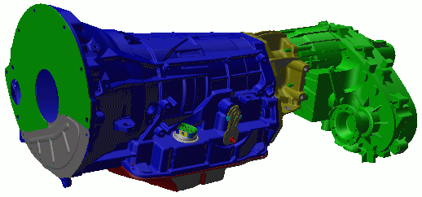
Car network
CD CHANGER
DISTRIBUTED
AMPLIFIERS
DVD
PLAYER
RADIO/ICU
CAN B / MOST Gateway
NAV
HVAC
INSTRUMENT PANEL
Instrument Cluster
Junction Block Module
HVAC Unit/Controller
Radio/ICU
Speakers
Switches
Lamps
Cigar Lighter/Power Outlets
Frontal Passive Restraints
SKIM
-
+
MOST
Media Oriented
Systems Transport
-
-
-
-
+
+
+
+
NAV
PHONE
DOORS
Window Motors
Lock Motors
Switches (window, lock, mirror, memory, disarm, ajar)
Mirrors
Courtesy Lamps
SEATS
power
heat
memory
switches
OVERHEAD
EVIC
Courtesy/Dome Lighting
Sunroof
INSTRUMENT CLUSTER
CAN B / CAN C Gateway
CAN B
Low Speed
Data Bus
+
-
+
-
+
-
SHIFTER
Shift by Wire
AutoStick
Shift Interlock
Illumination
ENGINE
Engine Controller
Sensors
Injectors
TRANSMISSION
Transmission Controller
Transfer Case Controller
ABS
CAN C
High Speed
Data Bus
+
-
-
-
+
-
+
+

Slide 10
CAN System: Summary
Multi-master priority-based bus access
Non-destructive Priority-based arbitration
Multicast frame transfer by acceptance filtering
Configuration flexibility
system-wide data consistency
Serial communication
Event triggered communication – When the data is ready, the node transmits
Distributed network- loosely coupled- No shared memory

Slide 11
CAN System: Summary
Error detection and error signalling
Automatic retransmission of frames that have lost arbitration or have been destroyed by errors during transmission
Distinction between temporary errors and permanent failures of nodes and autonomous switching-off of defective nodes
Bit rate: 5 Kbit/s – 1 Mbit/s

Slide 12
Message Types
Messages are one of four different types, called frames
Data Frame : used to transmit up to 8 bytes of data
Remote Transmission Request Frame : used to request a Data Frame (presently not used at DC)
Error Frame : used to indicate a bus error
Overload Frame : used to create an extra delay between Data Frames or Remote Frames (presently not used at DC)

Slide 13
Ethernet and CAN
By comparison, Ethernet's familiar Collision Sensing Multiple Access (CSMA) protocol allows all nodes equal access to the bus to transmit data. It resolves conflicts by having the nodes back off and rebroadcast after a pseudo-random time delay. The scheme works, but is also inefficient.
During high load conditions, for example, nodes trying to broadcast spend a good deal of their time getting on the bus, backing off, waiting to get on again, and colliding again. As a result, only about 60% of the theoretical bus throughput is ever utilized and Ethernet must go to higher and higher bus speeds to increase throughput.
CAN's protocol, on the other hand, provides nodes with intrinsic priorities so that even when all nodes attempt to access the bus simultaneously collisions and the subsequent back-off/retransmit cycle is virtually eliminated.

Slide 14
Non-destructive Arbitration
The net result of non-destructive arbitration is bandwidth utilization of 80% to 90% and very high reliability.
The scheme of having each node monitor its own broadcast and that of other nodes limits its maximum throughput to 1 Mbit/sec at the bus length of 30 meters.
Maximum bit rate can be increased by shortening the bus length.

Slide 15
Hardware Implementations
Using an external CAN controller
Using an internal CAN controller
Processor
CAN Protocol Controller
Processor with Integrated CAN Protocol Controller
Transceiver
Transceiver
CAN Bus Media

Slide 16
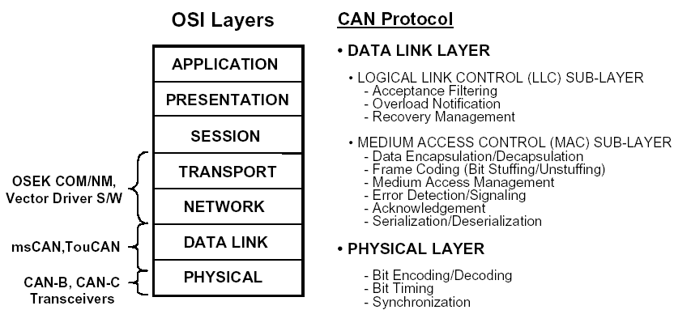
ISO/OSI Structure of a CAN Node

Slide 17
Message Transfer
Any one of free node can start to transmit.
Bus conflict resolved by bit-wise arbitration.
The highest priority message wins bus access.
Transmitting nodes which loose arbitration become receivers.
No data or time is wasted, someone always wins.
Nodes which loose arbitration will automatically retransmit.
Arbitration Field (identifier) determines the message priority.
Identifier - intended to label message contents (no physical node addresses).

Slide 18
Message Transfer (contd…)
All nodes check the consistency of messages received and will flag an inconsistent message to the entire network.
All receiving nodes will acknowledge a valid message.
A message is received correctly by all nodes or no nodes.
All nodes apply Message Filtering to decide whether to accept a message.
Any number of nodes can simultaneously receive and accept a message (Multicast transmission).

Slide 19
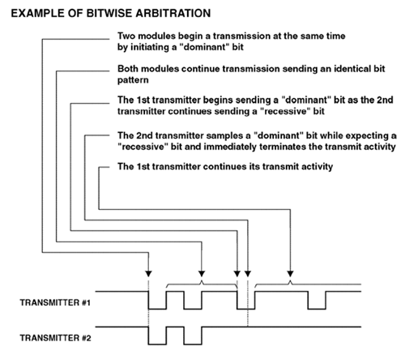
Bitwise Arbitration

Slide 20
Bitwise Arbitration Rules
A "dominant" bit always wins over a "recessive" bit (similar to open collector logic)
A transmitter always compares its transmit bit with its receive bit.
If a transmitter detects that the receive bit is not the same as the transmit bit, then the transmitter will immediately stop its transmission. (With some dependencies, a subsequent re-transmission may occur)

Slide 21
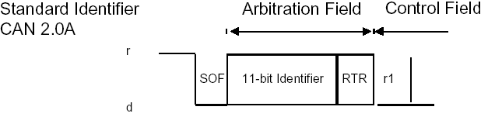
CAN Arbitration Field 2.0A
The 11-bit Identifier is labeled ID10 to ID0 in CAN2.0A.
The Identifier is transmitted most significant bit first.
The 7 most significant bits of the Identifier must not all be recessive, per the CAN Specification.
RTR bit is dominant for a Data Frame, recessive for a Remote Frame. r1 is always dominant.

Slide 22
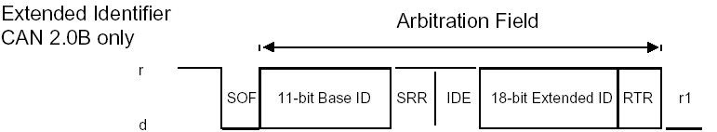
CAN Arbitration Field 2.0B (contd..)
The 11-bit Base Identifier is labeled ID28 to ID18.
The 18-bit Extended Identifier is labeled ID17 to ID0.
The Identifier is transmitted most significant bit first.
The 7 most significant bits of the Identifier must not all be recessive.
SRR bit is recessive for an Extended Identifier
IDE bit is recessive for an Extended Identifier.
RTR bit is dominant for a Data Frame, recessive for a Remote Frame.

Slide 23
CAN Protocol
CAN is a serial communication protocol
The bit-stream is coded as non-return-to zero (NRZ) method
Recessive
0
1
1
1
1
0
0
1
0
Dominant
Bit Stuffing is used: whenever 5 consecutive bits of equal value are transmitted, an extra bit of complementary value is inserted into the bit stream
CRC (Cyclic Redundancy Check): An error detection scheme based on n-bit division

Slide 24
CAN Data Frame
Recessive
IFS or
Bus Idle
SOF
1 bit
Arbitration Field
32/12 bits
Control Field
6 bits
Data Field
0-8 bytes
CRC Field
16 bits
ACK
2 bits
EOF
7 bits
IFS
3+ bits
Dominant
Bit Stuffing
Inter-Frame Space (IFS): A node may start transmitting a Data Frame.
Start Of Frame (SOF): Receivers synchronize at the leading edge.
Arbitration Field: Arbitration based on message ID
  12 (11+1) bits for a Standard Data Frame (CAN2.0A/B)
  32 (29+3) bits for a Extended Data Frame (CAN2.0B only).

Slide 25
CAN Data Frame
Recessive
IFS or
Bus Idle
SOF
1 bit
Arbitration Field
32/12 bits
Control Field
6 bits
Data Field
0-8 bytes
CRC Field
16 bits
ACK
2 bits
EOF
7 bits
IFS
3+ bits
Dominant
Bit Stuffing
Control Field: Defines Data/RTR frame & Data length
Data Field: 1-8 bytes of data
Cyclic Redundancy Check Field (CRC): 15-bit CRC + delimiter
Acknowledgement Field (ACK): 1-bit Acknowledgment + delimiter
End Of Frame Field (EOF): 7/8 recessive bits

Slide 26
CAN Data Frame (Contd.)
A simplified Data Frame Structure
Message ID 11 bit
DLC 4 bit
Byte 0 8 bit
Byte 1 8 bit
Byte 2 8 bit
Byte 3 8 bit
Byte 4 8 bit
Byte 5 8 bit
Byte 6 8 bit
Byte 7 8 bit
UP TO 8 DATA BYTES

Slide 27
CAN Cell structure
LOGICAL LINK CONTROL (LLC)
  Provide service access points
  Acceptance Filtering
  Overload notification
MEDIUM ACCESS CONTROL (MAC)
  Manage access control
  Data En(De)capsulation
  Bit (un)stuffing
  Error Detection/signaling
  Message Acknowledgement
PHYSICAL LINK
  Bit En(De)coding
  Bit Timing
  Clock synchronization
Logical Link Control
Medium Access Control
Physical Layer

Slide 28
Standard Software
Application
API
KWP 2000 TP
DB Comm
NM
CAN Driver
{
Logical Link Control
CAN Cell
Medium Access Control
Physical Link
Transceiver

Slide 29
CAN Error detection
  The following measures are provided:
Bit Error: Transmitter detected different bit level compared to the sent value
CRC Error: At receiver, calculated CRC does not match
Stuff Error: At receiver, six consecutive similar bits are observed
Form Error: Frame format is violated
Acknowledge Error: Transmitter failed to observe an acknowledgement

Slide 30
CAN Error Detection
Bit Error : a Bit Error is detected by a transmitter if the bit value received is different from the bit value transmitted.
Exceptions:- sending a recessive bit and receiving a dominant bit during the Arbitration Field or the Ack Slot, or during a Passive Error flag.
Stuff Error : a Stuff Error is detected by a receiver if 6 consecutive bit values are received during a message field that should be encoded by bit stuffing.
CRC Error : a CRC Error is detected by a receiver if the CRC calculated by the receiver is different from the CRC received in the CRC Sequence field.
Form Error : a Form Error is detected by a receiver if a fixed form bit field contains one or more illegal bits.
Acknowledge Error : an Acknowledge Error is detected by a transmitter if it does not receive a dominant bit during the ACK Slot.

Slide 31
CAN Error Signaling
A node which detects an error transmits an Error Flag.
When a Bit Error, a Stuff Error, a Form Error or an Acknowledge Error is detected, the Error Flag is started at the next bit time.
When a CRC Error is detected, the Error Flag is started at the bit after the ACK Delimiter (unless an Error Flag for another error condition has already started).
The transmission of a message in which an error is detected is recognized as not complete. The transmitting node will arbitrate for bus access after the Interframe Space following the Error Frame in an attempt to retransmit the message, and will continue to do so until the message is successfully transmitted (or the node becomes bus-off).

Slide 32
CAN Active Error Frame
An Error Frame consists of an Error Flag followed by an Error Delimiter.
There are 2 types of Error Flag: Active Error Flag and Passive Error Flag.
An Active Error Flag is transmitted when an error is detected by an Error Active node.
An Active Error Flag consists of 6 dominant bits, which overwrite other bits on the bus and break the rule of Bit Stuffing or destroy the ACK field or EOF field.
As a consequence, all other nodes detect an error, and transmit their own Error Flag, (and so no nodes receive the original message).
The number of dominant bits monitored on the bus can vary between 6 and 12.

Slide 33
CAN Fault Confinement
Fault Confinement attempts to identify permanent failures.
Nodes that persistently generate errors are prevented from disturbing communication between other nodes on the bus.
Each CAN node maintains a Transmit Error Counter and a Receive Error Counter
Each time an error is detected the error counters go up while after a successful transmission/reception it goes down
A node may be (error) normal, error active, error passive or Busoff

Slide 34
Clock Synchronization
Receiving nodes on the bus must synchronize their clocks
  Hard synchronizations are done at the beginning of each message
  Re-synchronization is done at each bit level by lengthening or shortening the bit time

Slide 35
Physical Interface
Three automotive standards: high speed differential (ISO 11898-2, SAE J2284), two-wire fault-tolerant (ISO 11898-3), and single-wire (SAE J2411)
High Speed Interfaces (Class C)
  Linear bus topology
  Bus speed up to 1 Mbps
Fault-tolerant interfaces (Class B)
  Automatically switches to single wire reception when fault detected
  Limited to 125kbps
  Flexible topology: bus, star, ring
Single Wire Interfaces (Class B)
  Based on J1850-VPW technology with enhanced wakeup capability
  Limited to 33.33kbps
  Flexible topology: bus, star, ring

Slide 36
CAN voltage level
5
V_{CAN-Low}
V_{CAN-Low}
5
V_{Bus}
4.5
V_{Bus}
4.5
4
V_{CAN-High}
4
V_{CAN-High}
3.5
3.5
3
3
2.5
2.5
V_{Diff}
2
2
1.5
1.5
1
1
V_{CAN-Low}
0.5
V_{CAN-Low}
V_{CAN-High}
V_{CAN-High}
0.5
0
0
Recessive
Dominant
Recessive
Recessive
Dominant
Recessive
CAN CLASS -B
CAN CLASS -C

Slide 37
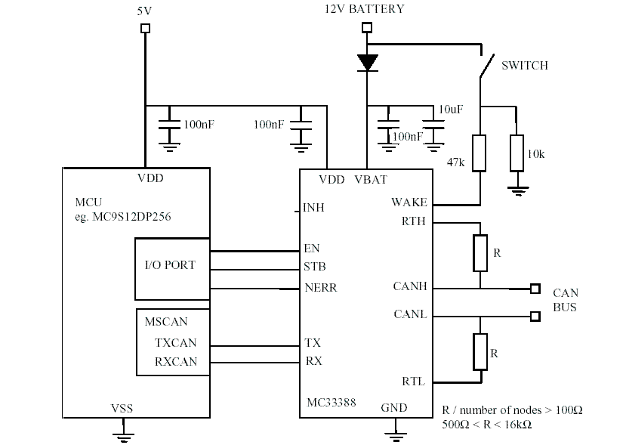
Typical CAN application circuit

Slide 38
MC9S12DP256B : 16-Bit Microcontroller
The MC9S12DP256B microcontroller unit (MCU) is a 16-bit device composed of standard on-chip peripherals :
  16-bit central processing unit (HCS12 CPU)
  256Kb of Flash EEPROM, 4.0Kb of EEPROM
  12.0K bytes of RAM
  2 SCI
  3 SPI
  5 CAN 2.0 A, B software compatible modules (MSCAN12), and an Inter-IC Bus.

Slide 39
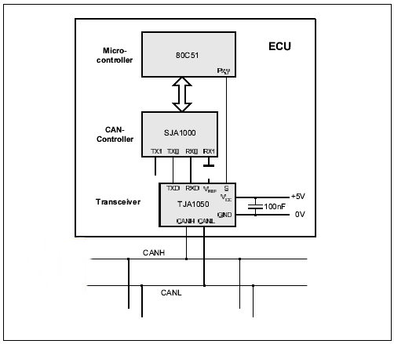
CAN ECU Configuration

Slide 40
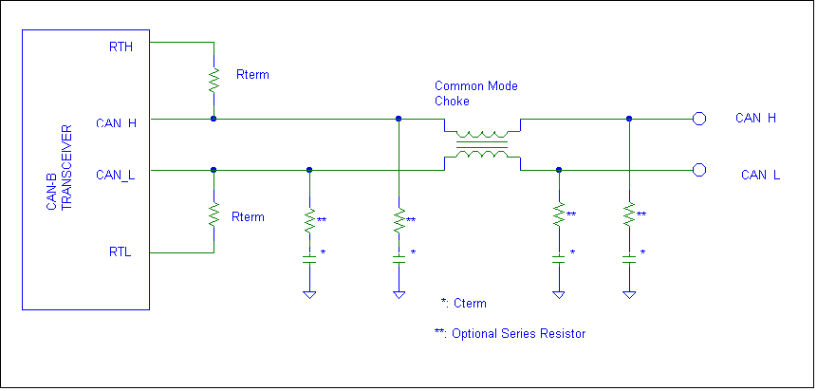
CAN B Termination

Slide 41
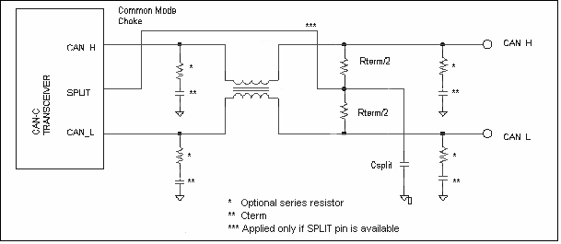
CAN C Termination

Slide 42
CAN bus speed
2004 -2006 Vehicles (PF-10647)
  Body bus - CAN 83.33 (KBS) : Class B (FT)
  Powertrain bus - CAN 500 (KBS) : Class C
  Diagnostic bus - CAN 500 (KBS) : Class C
Transition starting from 2007 vehicles (DC-10734)
  Body bus - CAN 125 (KBS) : Class C
  Powertrain bus - CAN 500 (KBS) : Class C
  Diagnostic bus - CAN 500 (KBS) : Class C
A Gateway exchanges signals in various buses

Slide 43
CAN OSC Tolerance
Oscillator tolerance is determined by the requirement that bit values remain synchronized between recessive to dominant edges.
Tol = | f - fn | / fn × 100%
fn = nominal CAN clock freq, f = actual CAN clock freq.
Can oscillator tolerance
PF 10647
  CAN 83.33 KBS 0.30%
  CAN 500 KBS 0.30%
DC 10734
  CAN 125 KBS 0.30%
  CAN 500 KBS 0.15%

Slide 44
CAN Development Tools
CANalyzer: Bus monitoring and analysis tool
CANoe: Bus simulation, monitoring and analysis
CANstress: Generate disturbances and analyze bus tolerance
CANscope: Shows CAN waveforms identifying all message bits (PC based)
Yokogawa CAN Oscilloscopes: Dedicated oscilloscopes for CAN
CANape: Accesses and calibrates internal data contents within an ECU through CAN bus (uses CCP Driver)
CAN I-Box: Interrogation, monitor and log signal values, send and monitor message.

Slide 45
CAN Analysis tools
CANalyzer and CANoe from Vector CANtech.
S-CAT and Hercules from Dearborn Group Technology.
NeoVI and Vehicle Spy from Intrepid Control Systems, Inc.

Slide 46
S-CAT/Hercules (Dearborn Group Inc.)
Super CAN Analysis Tool (SCAT) software supports advanced communication with in-vehicle CAN networks (J2411 [dual wire: T module] and ISO 11898 [single-wire: S module]; low-speed, mid-speed, and high-speed).
It is the ideal high-performance analysis tool for CAN network monitoring, simulation, diagnostics, and custom applications. Includes Scrolling, In-Place, and Signal monitors, as well as several views: Offline Buffer, Information, Diagnostics, Statistics.
Hercules (GRYPHON) and SCAT hardware provide convenient Ethernet connection to the user's PC; SCAT hardware was developed based on world-wide GM engineering specifications.

Slide 48
CANoe Simulation
Core Networking Provides CANoe Models
PC with CANoe
V. ECU3
V. ECU1
Real Can Controller
CAN stress
Real ECUn
Virtual CAN BUS
REAL CAN BUS
V. ECU2
Real ECU3

Slide 49
CANoe (Vector-CANtech Inc.)
CANoe (CAN Open Environment) is a powerful tool that supports the entire development process for networked systems, from planning through to placing the system in service.
CANoe is a tool for all users involved in the project:
  Support is provided for the person responsible for the system in the form of function distribution, function testing, and integration of the entire system.
  Simulation of remaining busses and environments provides suppliers with an ideal test environment.
  For projects with more than one supplier, mutually independent and parallel development of network nodes is possible (simultaneous engineering).

Slide 50
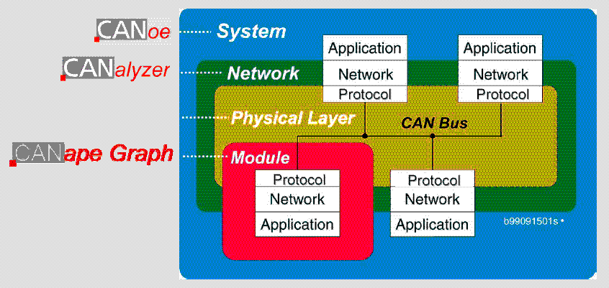
Vector Tool Chain

Slide 51
References
CAN Controller Area Network Technical Overview from Digital DNA from Motorola
Motorola Application note AN2255/D Rev.0,2/2002 – MSCAN Low power applications
http://www.vector-cantech.com/products/index.html
S-CAT Hand-on Hercules 3.0 Training material from Dearborn Group
CAN protocol Training material from Vector CANtech.
Introduction to CAN training from Intrepid Control Systems, Inc.
Bosch Controller Area Network (CAN) version 2.0 protocol standard document from Motorola’s website

Slide 52
References (contd…)
Vector Application note – Introduction to Can from Vector CAN-tech
Can: Network for thousands of applications outside automotive by Jack Shandle
LIN Consortium – (www.lin-subbus.org)
Motorola documentation –(http://mcu.motsps.com/documentation/index.html)
Automotive Home Page – (http://www.mot-sps.com/automotive)
Motorola LIN Software Inquiries – software.systems@helpline.sps.mot.com
www.osek-vdx.org

